Slide 1
Extracting Relational Facts by an End-to-End Neural Model with
Copy Mechanism
潘佳鑫

Slide 2
Introduction
Pipeline : entity recognition and relation extraction , neglects the relevance between these two sub-tasks
Joint model : statistical methods , neural methods
Statistical methods: heavily rely on complicated feature engineering
Neural methods: parameter sharing , no explicit features are used to model output-output dependencies

Slide 3
Introduction
Zheng et al. [2017] designs a novel tagging scheme. It only assigns a single tag to a word, which means one word can only participate in at most one triplet.
Such phenomenon makes aforementioned methods, whatever deep learning based models and traditional feature engineering based joint models, always fail to extract relational triplets precisely.

Slide 4
Abstract
Different relational triplets may have overlaps in a sentence
Propose an end2end neural model based on sequence-to-sequence learning with copy mechanism to extract relational facts from sentences, where the entities and relations could be jointly extracted.
Our model could consider the relational triplet overlap problem through copy mechanism.

Slide 5
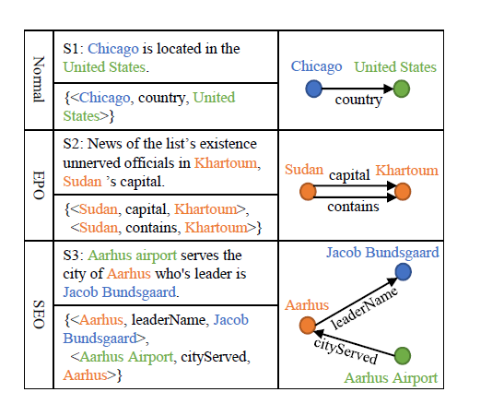
Three Types of Overlap Degree
Normal: none of its triplets have overlapped entities
EntityPairOvelap(EPO): some of its triplets have overlapped entity pair
SingleEntityOverlap(SEO): some of its triplets have an overlapped entity and these triplets don’t have overlapped entity pair

Slide 6
End2end Model Based on Seq2seq Learning
To generate a triplet, firstly, the decoder generates the relation. Secondly, by adopting the copy mechanism, the decoder copies the first entity (head entity) from the source sentence. Lastly, the decoder copies the second entity (tail entity) from the source sentence. In this way, multiple triplets can be extracted.
When decoding, we can either decode all triplets with one unified decoder or decode every triplet with a separated decoder. (OneDecoder or MultiDecoder)

Slide 7
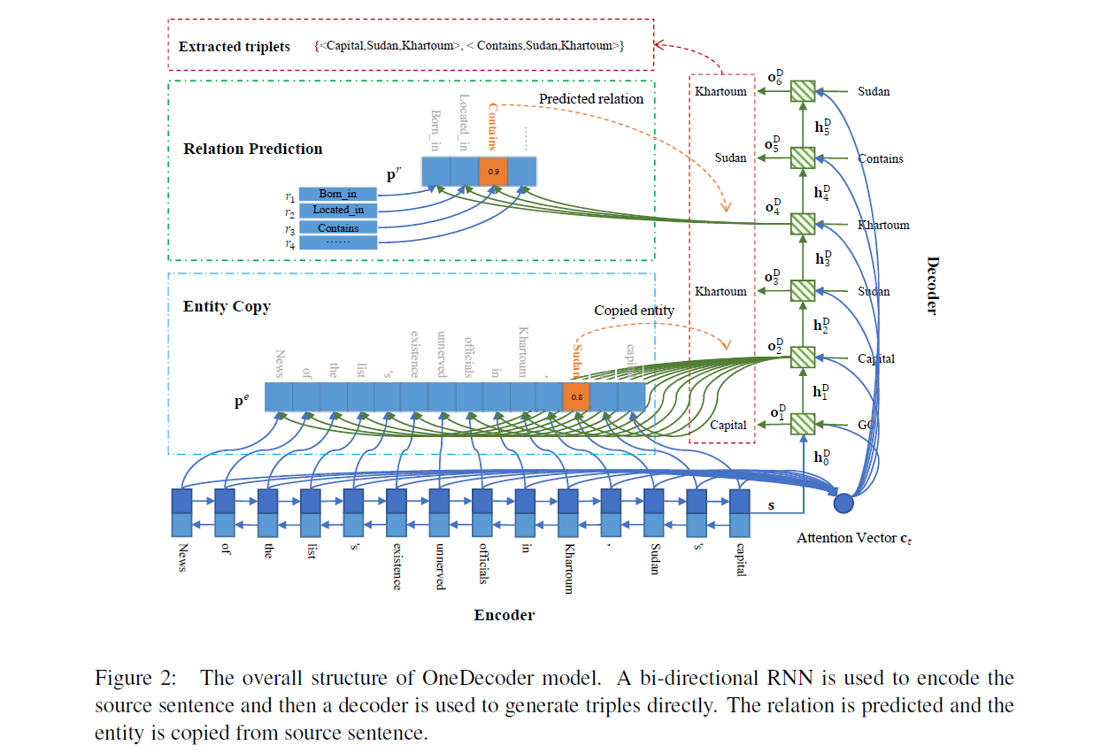

Slide 8
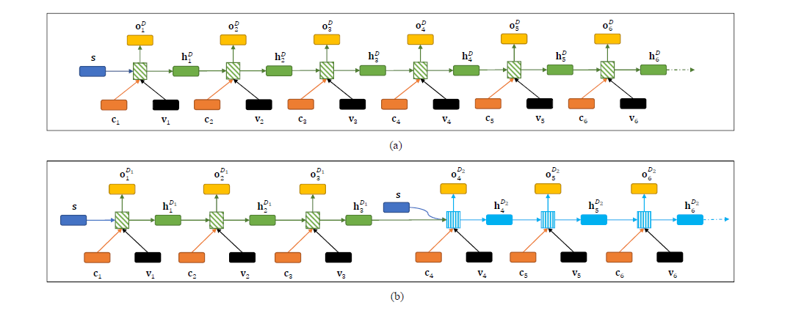


Slide 9


OneDecoder Model
Encoder
The output and hidden state in time step t
Bi-directional RNN

Slide 10


Decoder
The output and hidden state
Initialize with the representation of source sentence
Ut is the decoder input in time step t
Ct is the attention vector and Vt is the embedding of copied entity or predicted relation in time step t-1

Slide 11
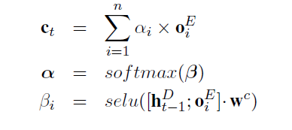
Attention Vector
If t%3=1:predict a relation, if t%3=2, copy the first entity ,if t%3=1, copy the second entity

Slide 12

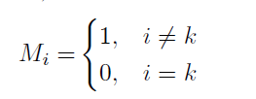



Predict Relation

Slide 13
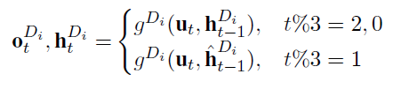

MultiDecoder Model

Slide 14
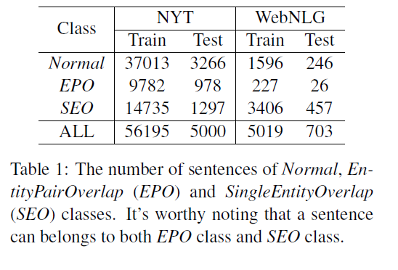
Experiment
Dataset: NYT, WebNLG
Baseline: NovelTagging model (Zheng et al., 2017)
Evaluation Metrics: Precision, Recall, F1 score

Slide 15
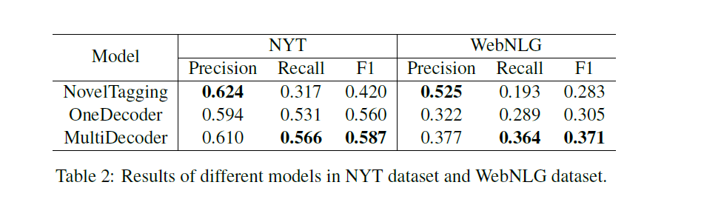
Results

Slide 16
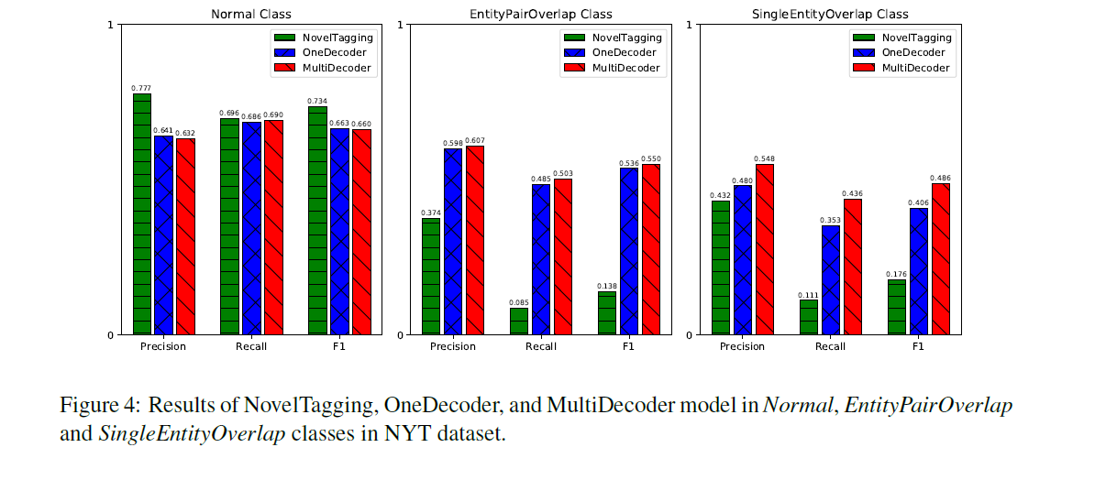

Slide 17
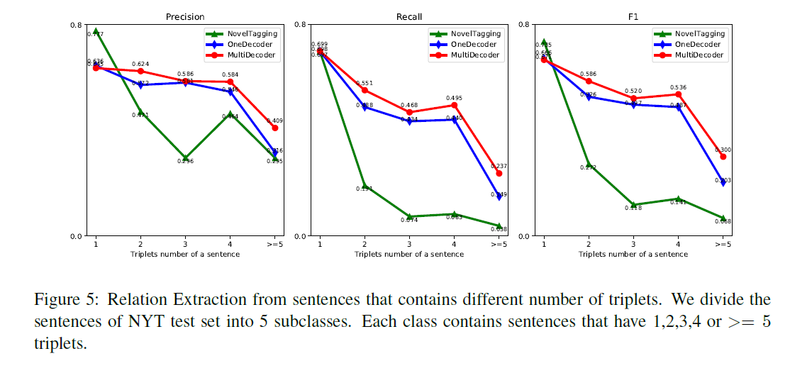

Slide 18
